Slide 1
Permissions

Slide 2
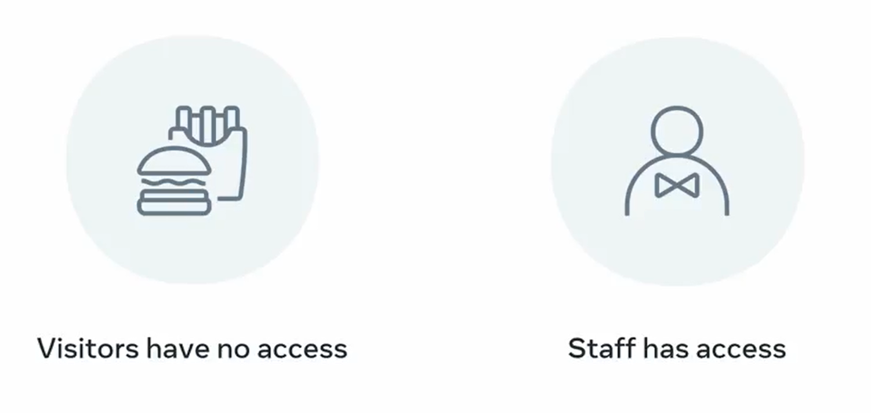

Slide 3


Slide 4
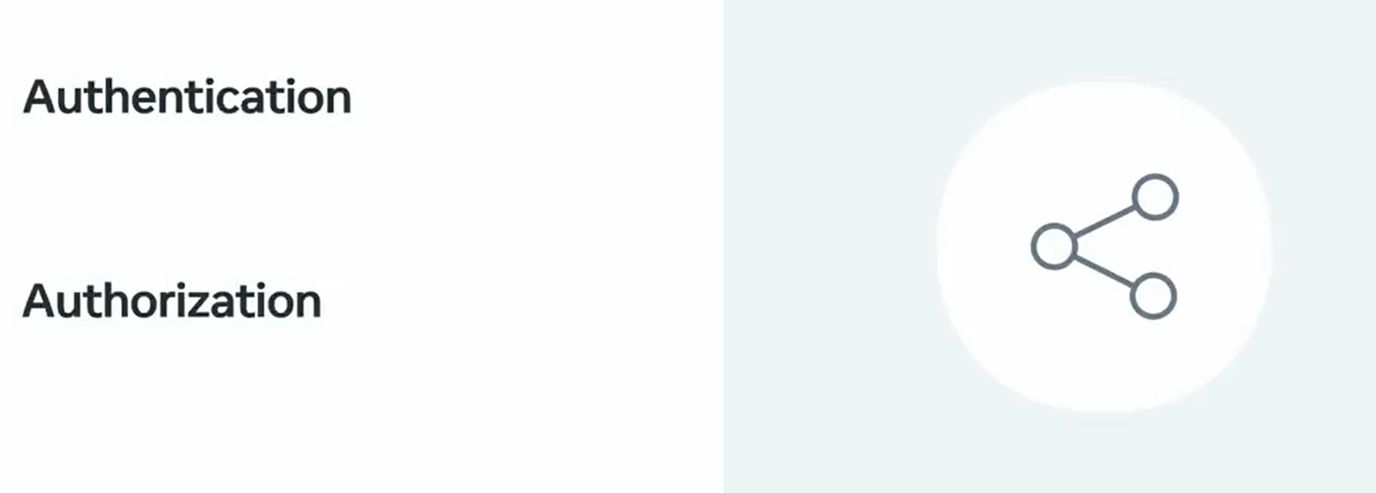

Slide 5


Slide 6


Slide 7


Slide 8


Slide 9

Create user through Django shell

Slide 10

Create user

Slide 11
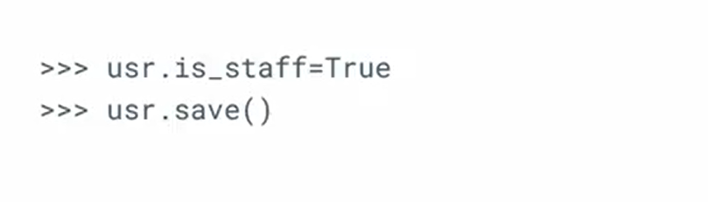
Create a staff user

Slide 12
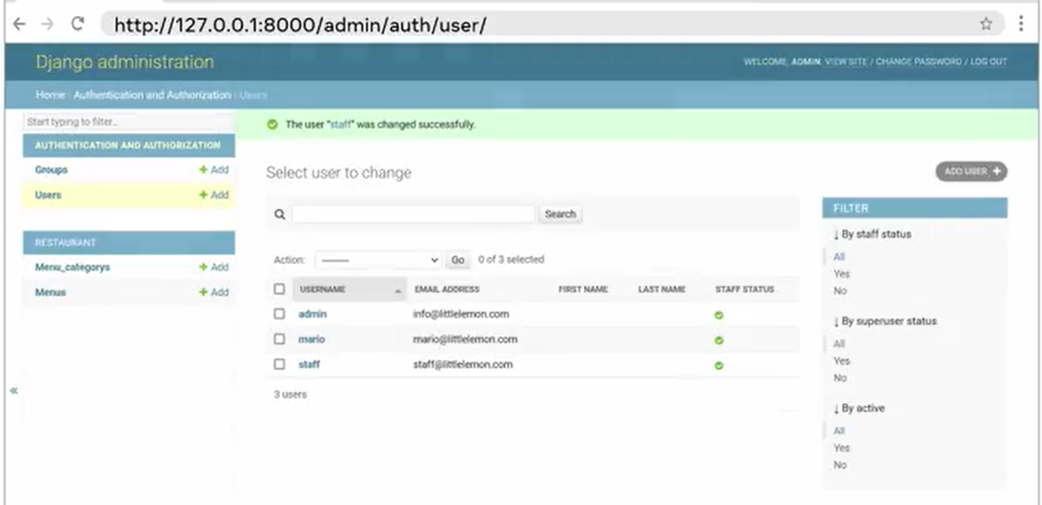

Slide 13
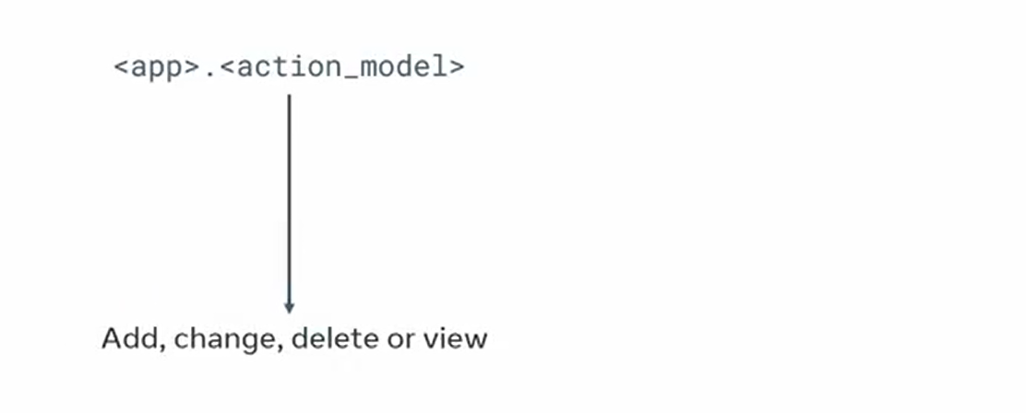
Enable permission settings

Slide 14
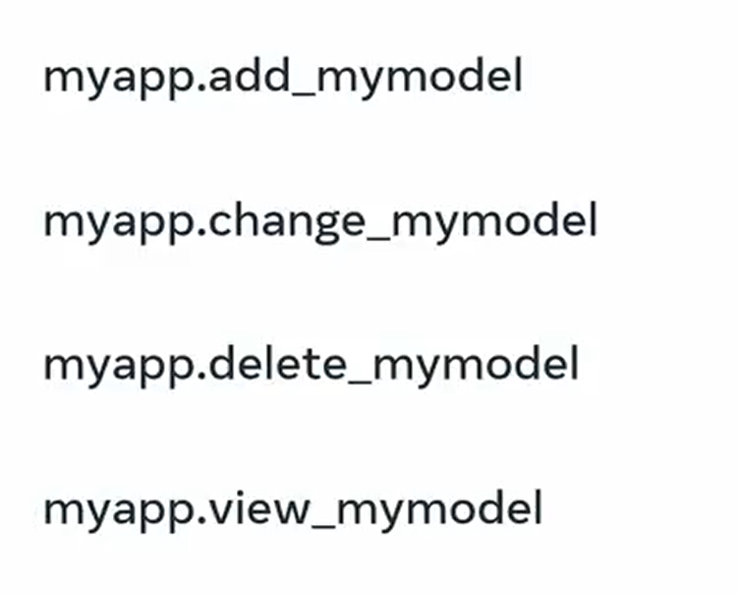
Permissions

Slide 15
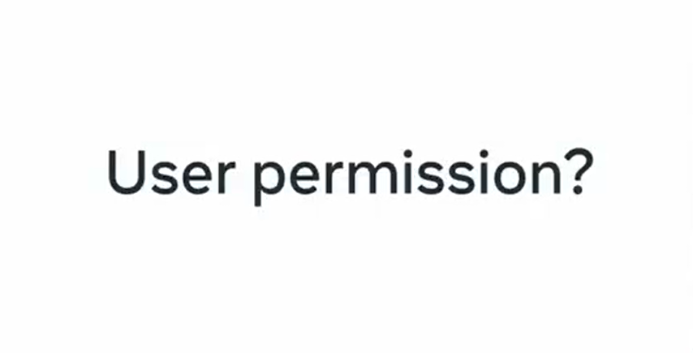

Slide 16
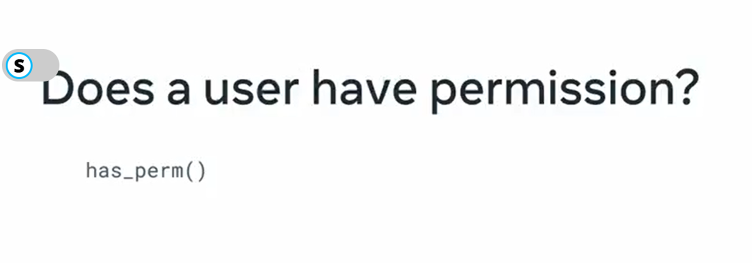
Does a user have permission ?

Slide 17
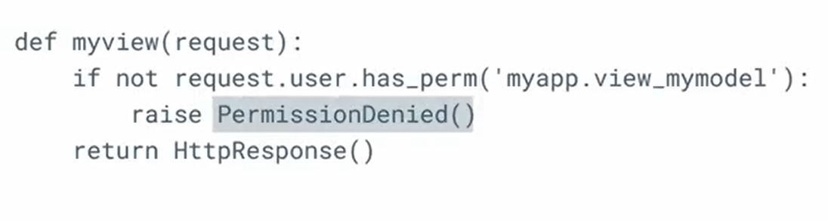
Permission denied error

Slide 18


Slide 19
